Slide 1

US HEALTHCARE ANALYSIS

Slide 2
Health Condition Insights: Gender Based Analysis
Key Insights:
Hypertension is the most prevalent condition (61% of the total cases).
Male Population is more prone to medical conditions like Hypertension and asthma.
Obesity is significantly higher in female population (62 %) indicating potential lifestyle or biological factors.
Arthritis and asthma show a near equal gender split with arthritis slightly more common in females and asthma in males.
Cancer affects both the genders equally.(836 Females vs 811 Males)
Notes:
WE CAN ADD NOTES HERE

Slide 3
Health condition Insights: Blood Group Based Analysis
Key Insights :
Hypertension is the most common condition (2155 cases), with B+ having the highest cases (282).
Cancer cases are evenly distributed across blood groups, ranging from 189 to 218.
Obesity is highest in AB- (239) and lowest in B+ (182).
Arthritis cases are fairly balanced, with AB+ (219) showing the highest count.
Asthma is most common in A+ and O+ (210 each).
Diabetes cases are lowest in O+ (155) and highest in B- (197).
All blood groups have a near-equal share in total cases (~12.5%).

Slide 4
Admission Type Analysis
Key Insights:
Emergency cases have the highest revenue
share ($87 M) and highest average billing amount ($24,279), with an increase of 4% from the overall average.
Elective admissions contributes almost
$70.9 M with an average billing amount $23,029, slightly lower (-1%) than the overall average.
Urgent cases generates $75.8 M revenue but with a lower (-3%) average billing amount i.e. $22,731.
Balanced distribution among admission types, but cost variation suggests different resource utilization.

Slide 5
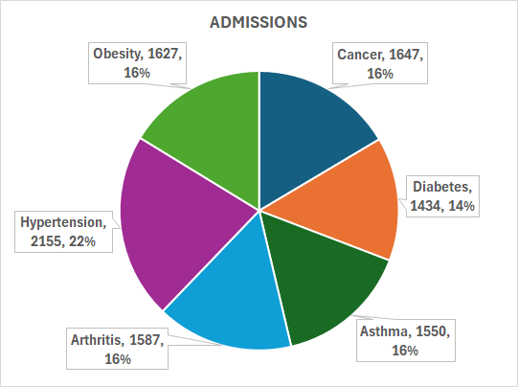
Medical condition Analysis
Cancer patients on an average pay 70% more ($ 39677) than the overall average billing amount.
Hypertension admissions are around 22% of the total admissions but has an average billing amount of $ 17,643 which is 25% lower than the overall average.
Lowest admissions are from diabetes ( 14% ) yet the average billing amount ($ 30070) is 29% higher than the overall average.
Obesity, Asthma and Arthritis show fairly equal admissions whereas obesity has a lower average billing amount($ 12,536) which is almost half of the overall average.

Slide 6
CONCLUSION
Hypertension is the most prevalent condition (22% of total cases), with a higher risk for males (61%). Obesity and diabetes are more common in females, indicating potential lifestyle or metabolic factors.
Blood group distribution shows no major disparities, but certain conditions (e.g., obesity in AB-) show variations.
Emergency admissions drive the highest revenue ($87M) and cost per case ($24,279), while urgent admissions have the lowest average billing.
Cigna and Aetna lead in billing per admission, while Medicare and UnitedHealthcare have lower average costs. Differences suggest variations in coverage policies and patient demographics.
Overall, the data highlights key trends in disease prevalence, gender distribution, and healthcare costs, offering insights for targeted healthcare strategies and resource allocation.

